Slide 1
How Operating System works?

Slide 2
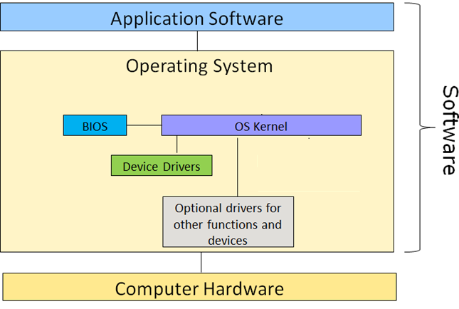
How Operating System works
The following elements (in block diagram) enable an OS to work with the computer:
BIOS
OS kernel
Device drivers

Slide 3
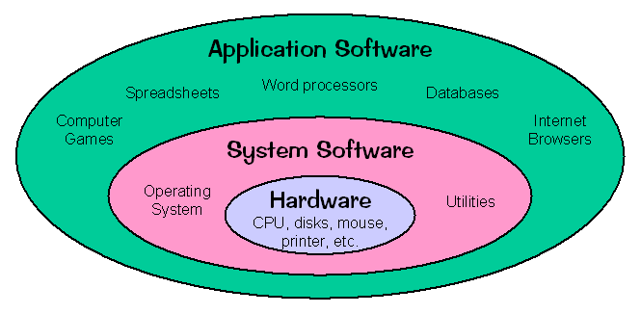
Computer Software (Recap)
Computer software is a series of related instructions that tells computer what tasks to perform and how to perform them.
The two categories of software are system software and application software.

Slide 4
The Role of BIOS & Boot Process
When a computer is turned on, the boot process starts; it jumps to a program inside the Basic Input/Output System (BIOS).
The BIOS is the low level program code that:
Initiates and enables communications with hardware devices e.g. keyboard, monitor, etc
Performs power-on self test (POST) to test keyboard, CPU, memory, disk drives, etc
Loads an operating system that interface with user
The BIOS program is stored in nonvolatile random access memory (NVRAM) chip.

Slide 5
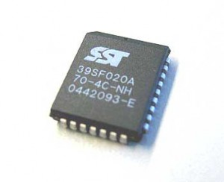
The Role of BIOS
The type of NVRAM chip used to store the BIOS is called a complementary metal semiconductor (CMOS) memory chip.
The content in the NVRAM is retained even when electric power is switched off (i.e. nonvolatile).
Hence, the BIOS program can be accessed when the computer first powered on.
CMOS

Slide 6
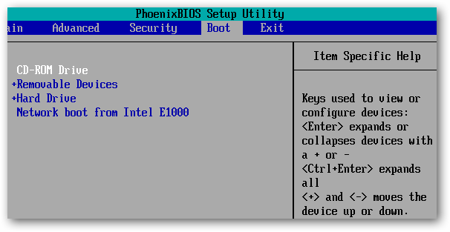
The Role of BIOS
User is prompted to press a specific key to enter the BIOS setup screen, if there is a need to change the settings.
A BIOS setup screen is shown below.

Slide 7
OS Kernel
Core services provided by an operating system are collectively called the kernel of an operating system.
Kernel performs functions such as process, memory and device management.

Slide 8
Device Drivers
The OS communicates with devices via the device drivers.
A device driver is a program that controls a particular type of device that is attached to your computer e.g. device driver for monitor, mouse, etc.
A device driver translates computer code to display text on a monitor screen, or translates movements of a mouse into action.

Slide 9
How Operating System works
The following elements (in block diagram) enable an OS to work with the computer:
BIOS
OS kernel
Device drivers

